Slide 1




Exploring Music Preferences: A Survey on Listening Habits and Trends
An Analysis of Music Listening Behavior
PRATHAM CHOWDHURY AND TEAM
00
Date: 25/11/24
Fundamentals of Computer Applications (24BCA1C05)
Jain (Deemed-to-be) University

Slide 2


- Background: Music is a vital aspect of human life, transcending cultures and generations. It shapes our emotions, influences our productivity, and serves as a medium for personal expression. With the rise of digital platforms, music consumption has evolved dramatically, making it essential to understand current listening trends.
- Importance of Study: This survey aims to shed light on how individuals engage with music daily. By examining listening habits, preferences for genres and platforms, and the emotional impacts of music, this study provides valuable insights for artists, streaming services, and marketers.
- Focus of Survey: The survey investigates general trends in music listening habits while exploring how these habits influence daily life. This understanding will enable stakeholders to tailor their offerings to better align with listener preferences.
INTRODUCTION
01
Fundamentals of Computer Applications (24BCA1C05)
Jain (Deemed-to-be) University

Slide 3

02
PRIMARY OBJECTIVES
- Analyze the frequency and duration of music listening habits among various demographics
- Identify popular music genres and preferred platforms for listening.
- Explore the emotional and functional impact of music on individuals' lives.
- Provide insights into how demographic factors influence music preferences.
Fundamentals of Computer Applications (24BCA1C05)
Jain (Deemed-to-be) University

Slide 4

CONTRIBUTION
03
Significance
This report contributes to a deeper understanding of how people interact with music in their daily lives. It provides valuable data for music streaming platforms, marketers, and industry professionals aiming to align their services with audience preferences.
Target Audience
The findings are particularly relevant for artists seeking to connect with listeners, streaming services looking to optimize their offerings, and marketers aiming to craft targeted campaigns based on listener behavior.
Future Research Directions
The report highlights the evolving role of music in the digital age, paving the way for future research on cultural influences in music consumption. It encourages further studies that delve into regional differences in musical tastes.
Fundamentals of Computer Applications (24BCA1C05)
Jain (Deemed-to-be) University

Slide 5

METHODOLOGY
EXPLORING MUSIC PREFERENCES
04
Distribution Method: Conducted via Google Forms to ensure wide accessibility and ease of participation.
Duration: The survey was designed to take approximately 5-10 minutes to complete, balancing thoroughness with respondent convenience.
Anonymity Assurance: All responses are anonymous except for recorded email addresses used solely for verification purposes. This approach encourages honest feedback while protecting respondent privacy.
Fundamentals of Computer Applications (24BCA1C05)
Jain (Deemed-to-be) University

Slide 6
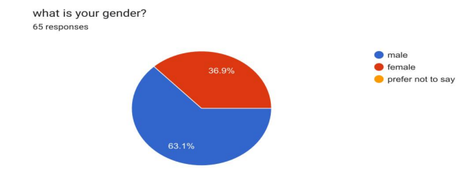
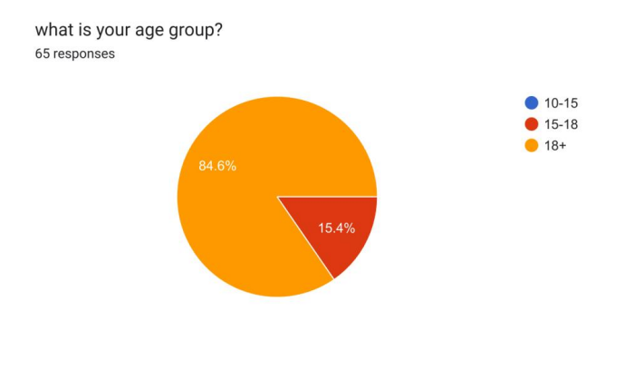
RESPONDENT DEMOGRAPHICS
Gender Distribution:
- Male: 63.1%
- Female: 36.9%
- Prefer not to say: 0%
Age Groups:
- Ages 10-15: 0%
- Ages 15-18: 15.4%
- Ages 18+: 84.6%
The majority of respondents fall within the age group of 18+, indicating that the findings may be more reflective of young adults' listening habits. The gender distribution appears balanced, allowing for diverse perspectives in the data collected.
05
Fundamentals of Computer Applications (24BCA1C05)
Jain (Deemed-to-be) University

Slide 7
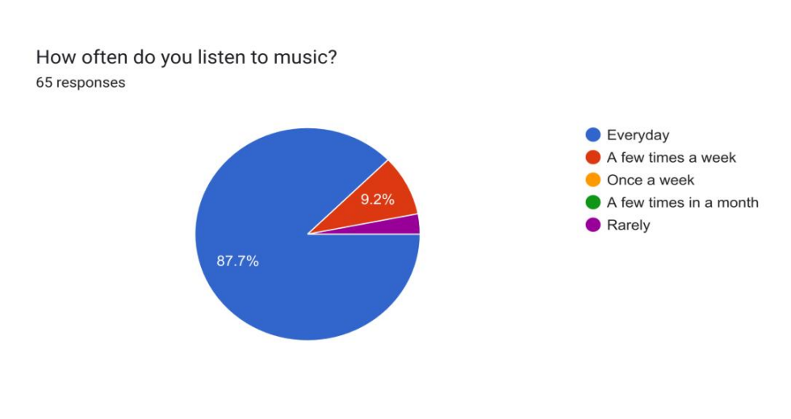
How often do you listen to music?
06
Fundamentals of Computer Applications (24BCA1C05)
Jain (Deemed-to-be) University

Slide 8
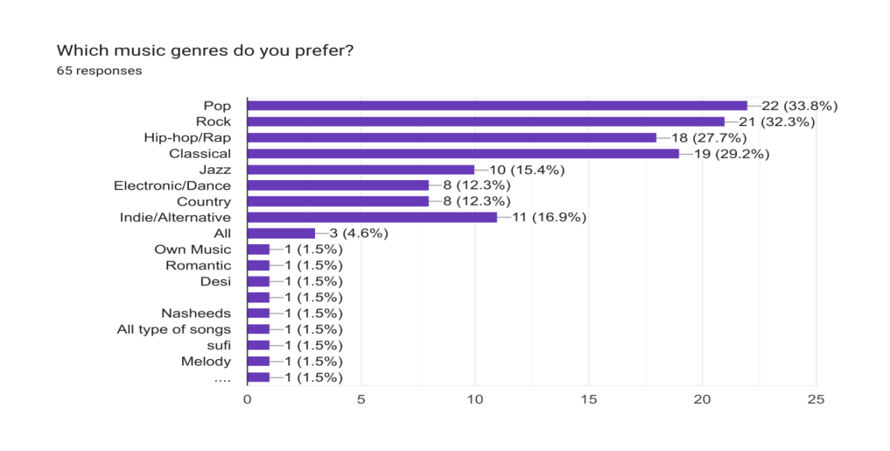
Which music genres do you prefer?
07
Fundamentals of Computer Applications (24BCA1C05)
Jain (Deemed-to-be) University

Slide 9
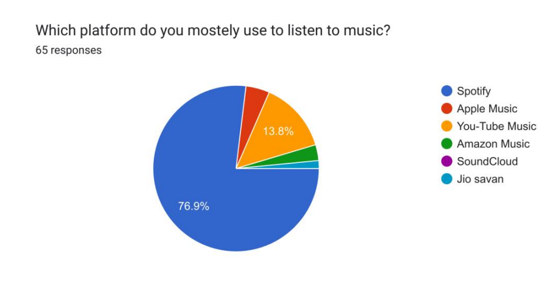
Which platform do you mostly use to listen to music to ?
08
Fundamentals of Computer Applications (24BCA1C05)
Jain (Deemed-to-be) University

Slide 10
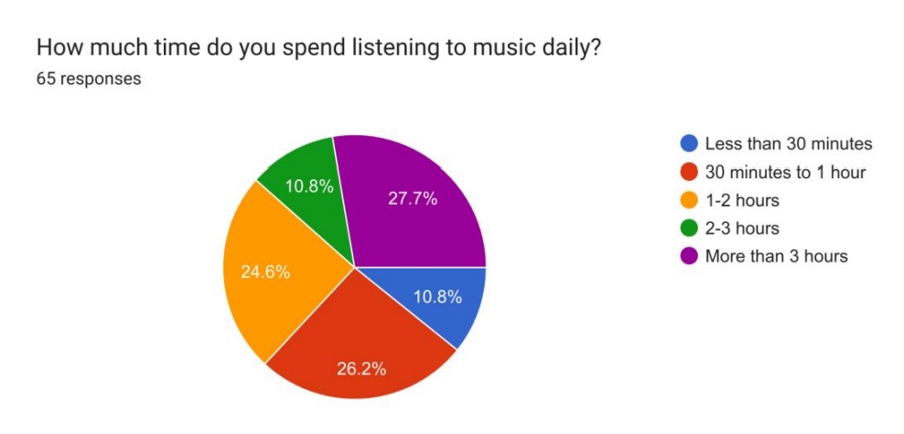
How much time you spend on listening to music daily:
09
Fundamentals of Computer Applications (24BCA1C05)
Jain (Deemed-to-be) University

Slide 11
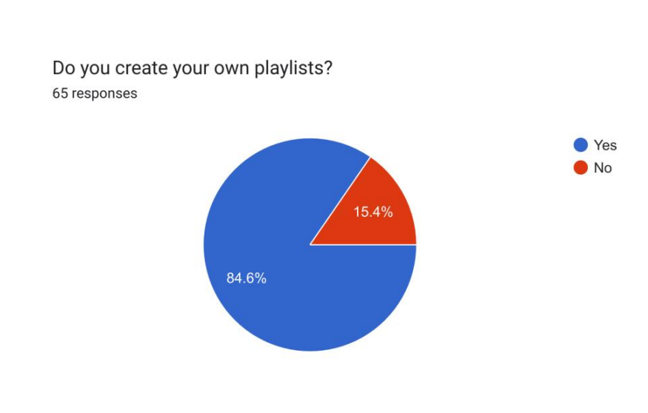
Do you often create your own playlists?
10
Fundamentals of Computer Applications (24BCA1C05)
Jain (Deemed-to-be) University

Slide 12
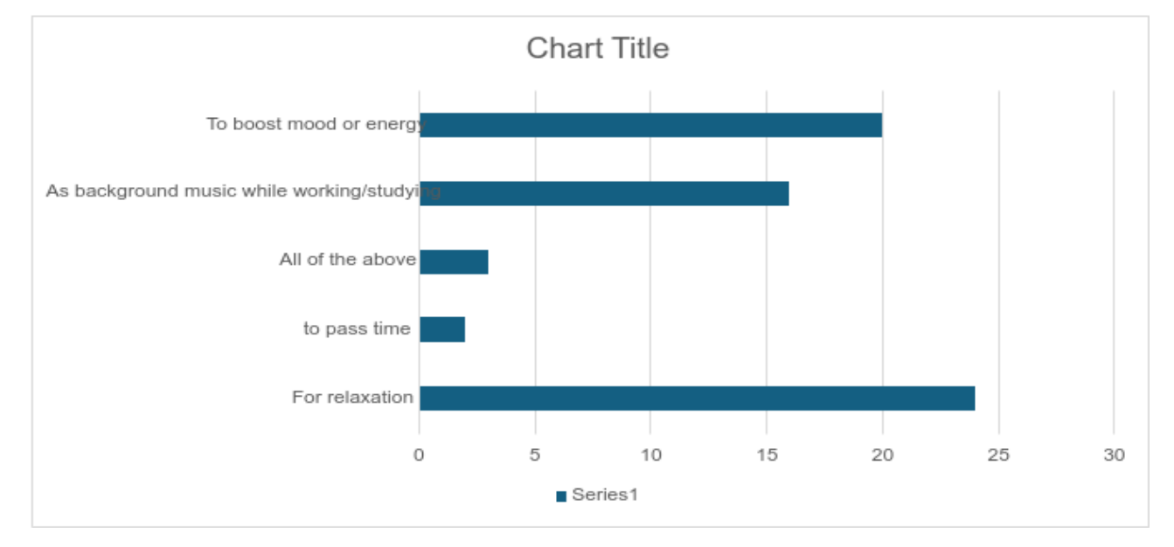
Music and mood:
11
Fundamentals of Computer Applications (24BCA1C05)
Jain (Deemed-to-be) University

Slide 13
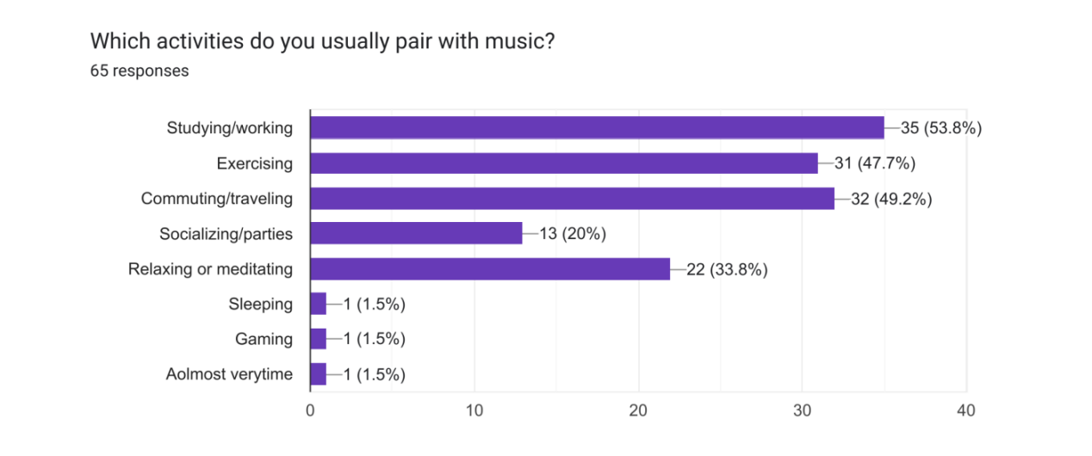
Activities done along with music:
12
Fundamentals of Computer Applications (24BCA1C05)
Jain (Deemed-to-be) University

Slide 14
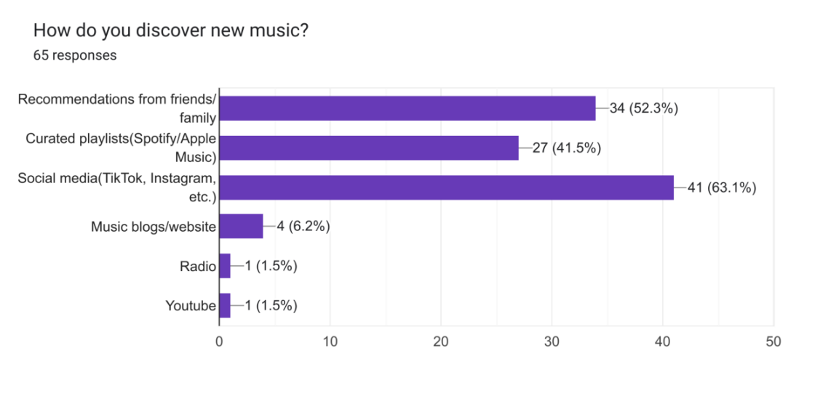
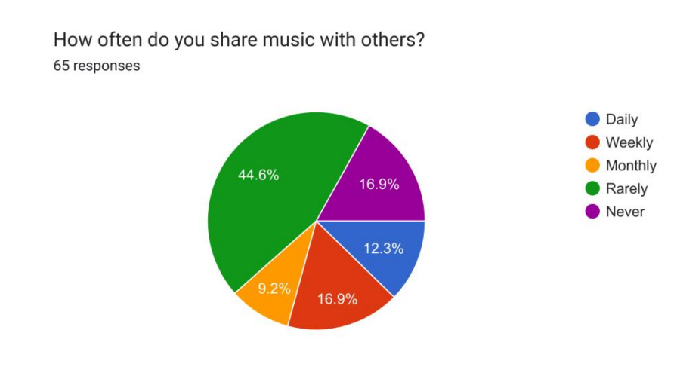
Discovering new music & sharing music with others:
13
Fundamentals of Computer Applications (24BCA1C05)
Jain (Deemed-to-be) University

Slide 15
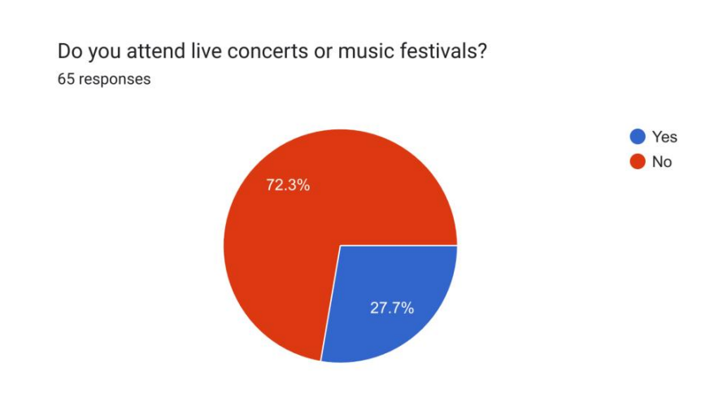
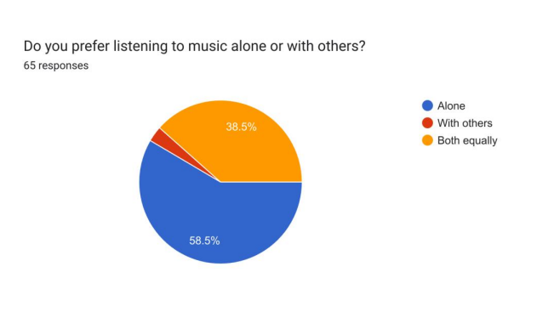
Do you attend concerts, and you prefer listening to music alone or with others?
14
Fundamentals of Computer Applications (24BCA1C05)
Jain (Deemed-to-be) University

Slide 16
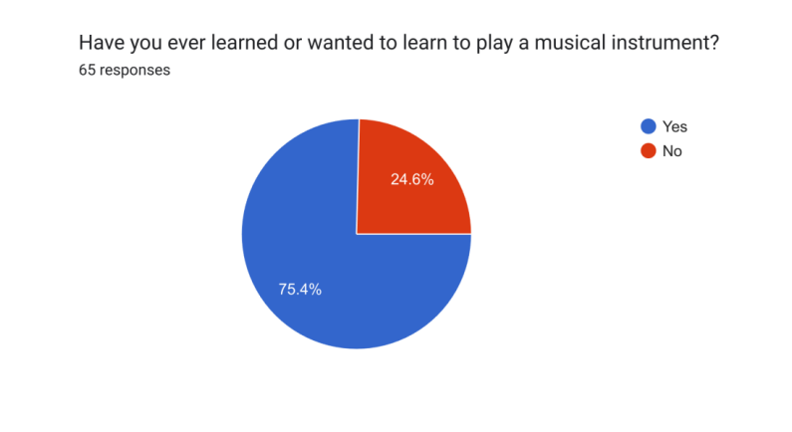
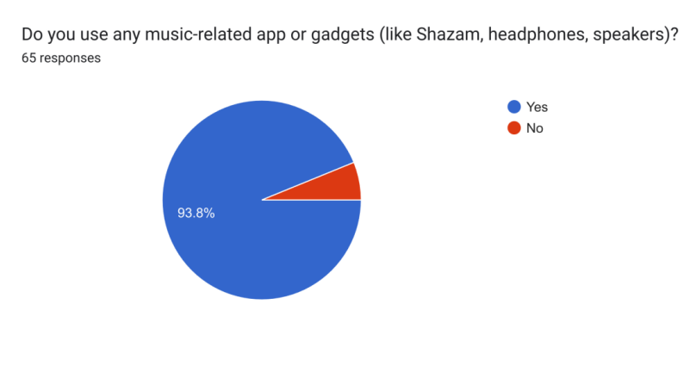
Ever wanted learn or played a music instrument and do you use music related apps and gadgets?
15
Fundamentals of Computer Applications (24BCA1C05)
Jain (Deemed-to-be) University

Slide 17
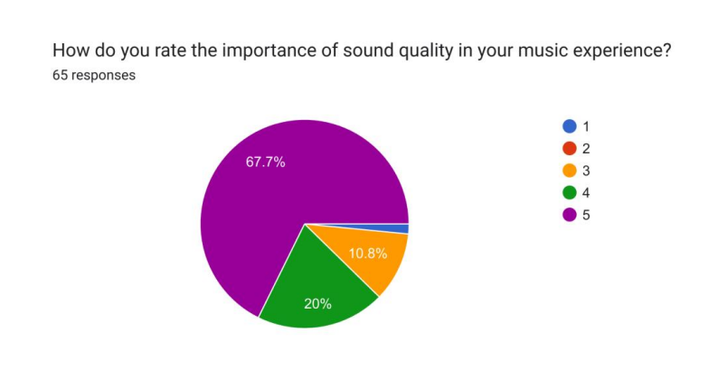
Sound quality is important:
16
Fundamentals of Computer Applications (24BCA1C05)
Jain (Deemed-to-be) University

Slide 18

SURVEY FINDINGS OVERVIEW
17
Key Findings Summary: A vast majority (87.7%) listen to music daily or several times a week, underscoring its omnipresence in everyday life.
Popular genres include Pop (38.8%) and Rock (32.3%), reflecting mainstream trends.
Streaming platforms like Spotify (76.9%) dominate listener preferences due to their extensive libraries and user-friendly interfaces.
Fundamentals of Computer Applications (24BCA1C05)
Jain (Deemed-to-be) University

Slide 19

IMPACT OF MUSIC ON MOOD
18
Emotional Influence:
- A significant portion (70%+) rates the impact of music on mood as strong (4 or above on a scale), indicating that many respondents rely on music for emotional regulation.
Primary Reasons for Listening:
- Relaxation (38.5%) and mood enhancement (32.3%) are leading reasons for listening to music. These findings suggest that individuals use music as a tool for emotional well-being.
Fundamentals of Computer Applications (24BCA1C05)
Jain (Deemed-to-be) University

Slide 20

CONCLUSION
19
Conclusions Drawn:
- Music plays a crucial role in enhancing relaxation, lifting moods, and boosting productivity among respondents.
- High engagement with digital platforms indicates a shift towards streaming services as primary sources for music consumption.
LINKS
https://docs.google.com/forms/d/e/1FAIpQLSd8xe5t9xuwvs843ifI59p-5GjR8mm4fnnXiHmGEDQpo5kiWw/viewform?usp=sf_link
Fundamentals of Computer Applications (24BCA1C05)
https://jainuniversityacin-my.sharepoint.com/:w:/g/personal/juug24bca17306_jainuniversity_ac_in/ESIjb_IHdShEq-ZzQ623NRQBLvwqM7clXJUOLmD9_14dgg?e=I8bczR
Jain (Deemed-to-be) University

